Slide 1
CITY CONNECT CAR LOAN PROCESSING SYSTEMS

Slide 2

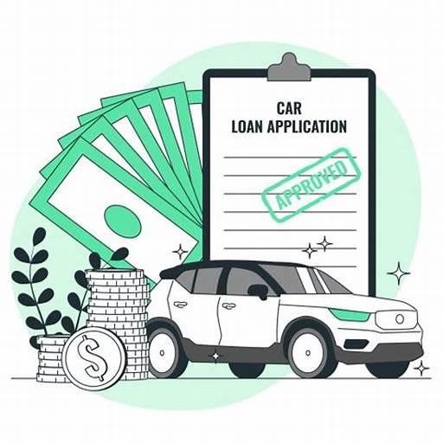
CONTENTS
INTRODUCTION
REQUIREMENT ANALYSIS
FLOW DIAGRAMS
PHASES

Slide 3
INTRODUCTION

Slide 4
The tasks involve loading applicant and car loan details into the bank's database, updating repayment details from collection agencies and CITY CONNECT Bank, and generating daily and weekly reports on car loan repayments. Additionally, there is a task for cleaning up and loading applicant, car loan, and payment data into the history database.

Slide 5
REQUIREMENT ANALYSIS

Slide 6
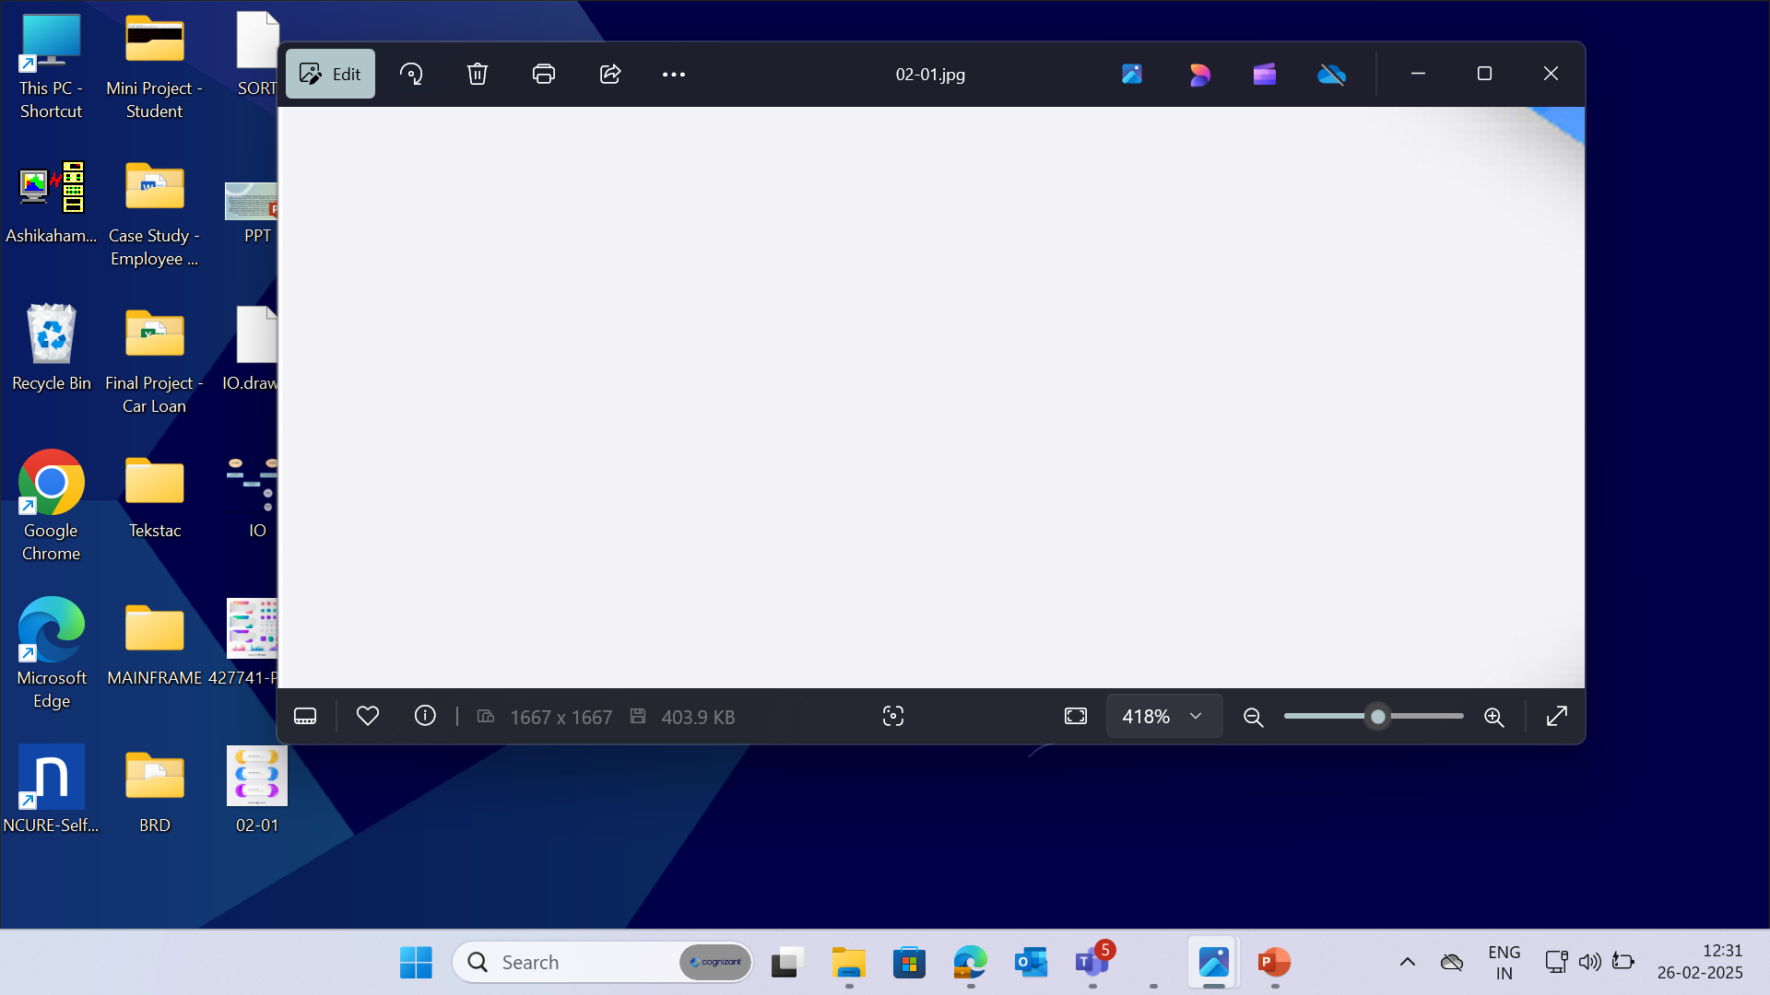


PCOMM Emulator - to access the Mainframe environment.
Pcom Emulator
SOFTWARE
REQUIREMENTS
DB2 - used for storing
the data in format.
TSO, JCL – to run and execute programs.
COBOL – to access inputs and perform required computations.
6
© 2025–2027 Cognizant | Private

Slide 7
CONTEXT FLOW DIAGRAM

Slide 8
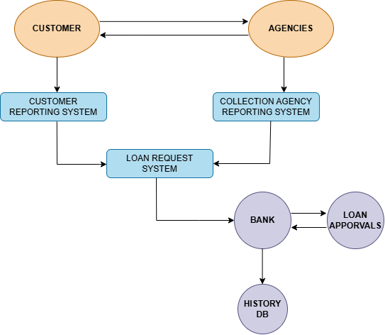
The context flow diagram shows loading applicant and car loan details, updating repayment information, generating repayment reports and cleaning/loading data into the history database.

Slide 9
DATA FLOW DIAGRAM

Slide 10
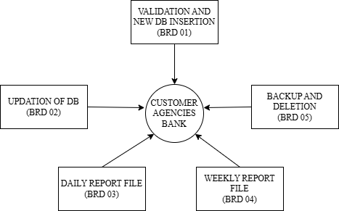
The Data Flow Diagram (DFD) visually represents the flow of data within a system, illustrating how data is processed.

Slide 11
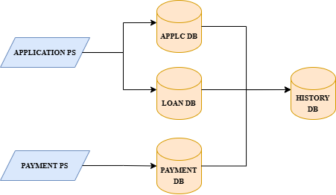
The below Flow Diagram depicts the overall process done in Car Loan Processing systems.

Slide 12
BUSINESS REQUIREMENT OVERIEW

Slide 13
BRD 02 - ADVAIT RANE
(2372575)

Slide 14
BRD : 02 - Monthly Car Loan Repayment Update
The process involves obtaining car loan payment details from banks and collection agencies, calculating the total amounts paid via cheque and cash modes, and updating the payment database with recalculated balances after applying a 2% tax. Payment details are loaded into the database, loan details are updated, and the Master Loan VSAM KSDS file is revised. Finally, accumulated amounts for each Loan ID are calculated and inserted into the Master Loan VSAM file.

Slide 15
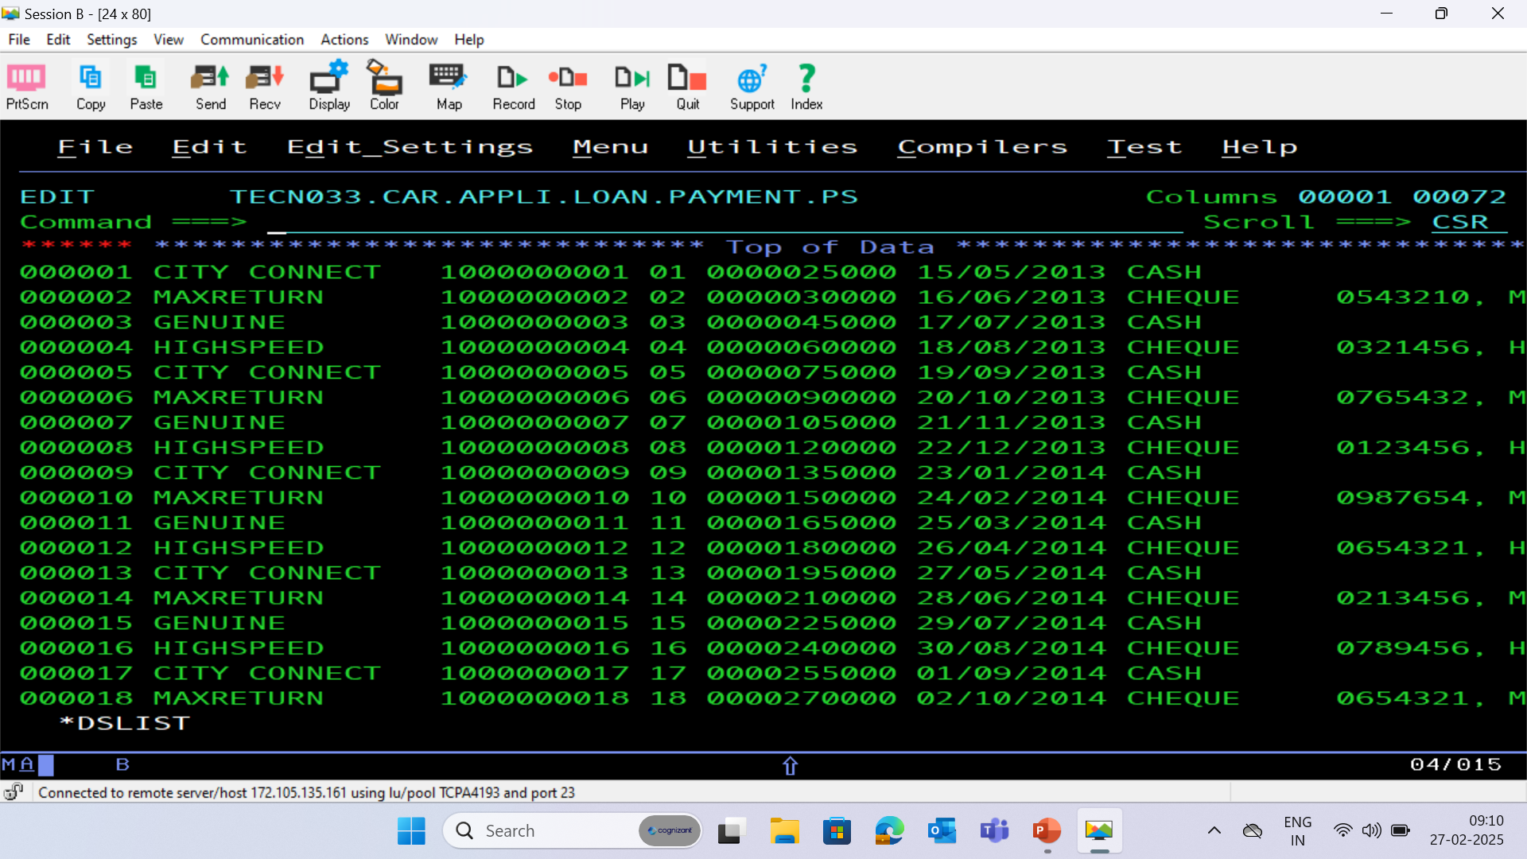
PAYMENT PS FILE

Slide 16
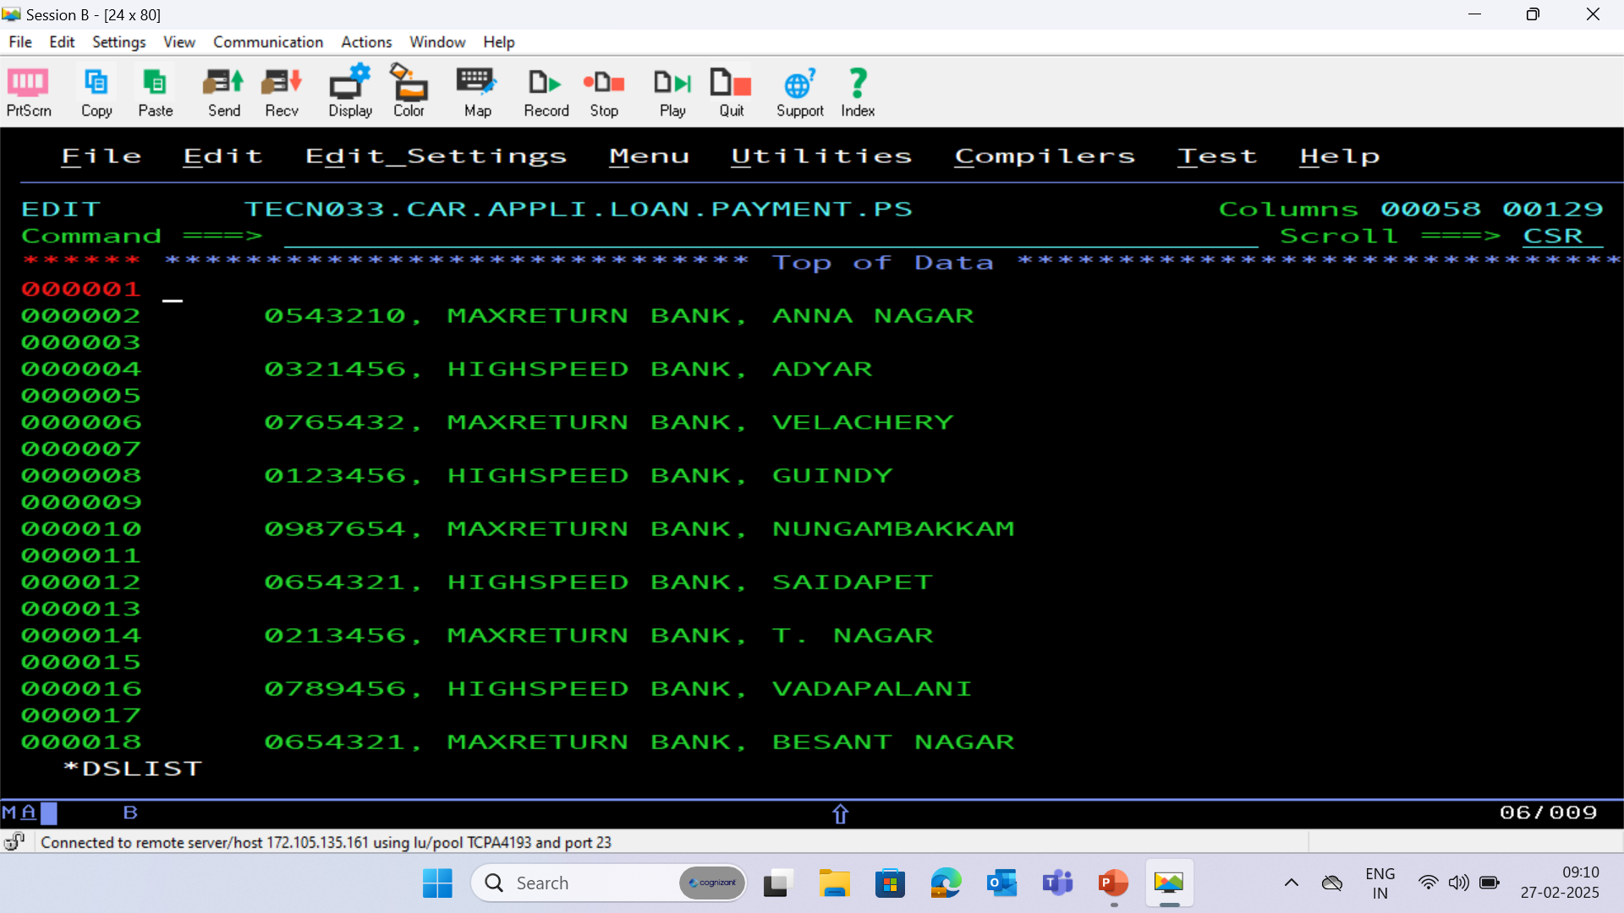

Slide 17
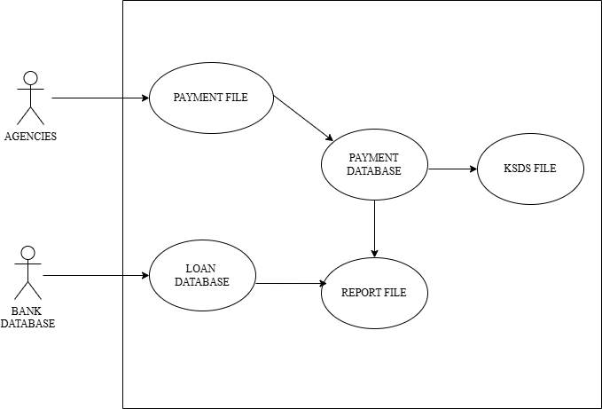
BRD : 02 – Use Case Diagram

Slide 18
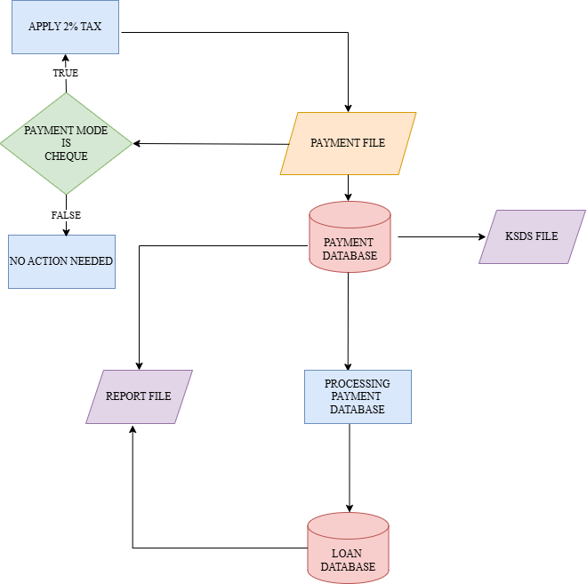
BRD : 02 – Flow Chart

Slide 19
PROCESS FLOW
Collecting Payment Details
Payment details for car loans are collected from banks and collection agencies and are used to create a comprehensive loan repayment detail file. This ensures all payment information is captured for further processing.
2. Calculating Payment Totals
The total amounts paid via cheque and cash modes are calculated, along with the number of payments made using each mode.
3. Updating Balance Amounts
For applicants who made payments via cheque, the balance amounts are recalculated, and a 2% tax is applied to the amount paid. The recalculated amounts are then updated in the payment database to reflect accurate financial records.

Slide 20
4. Loading Payment and Loan Details
Payment details, including the amount paid, payment date, previous and current balance amounts, payment mode, and cheque details, are loaded into the Payment Database. Similarly, loan details are updated, including the loan indicator, next repayment due date, and balance amount.
5. Generating Reports
Details of applicants with loan tenures greater than two years are extracted from the Loan Database. Separate report files are generated for these applicants in a standard format, ensuring organized data presentation and readability.

Slide 21
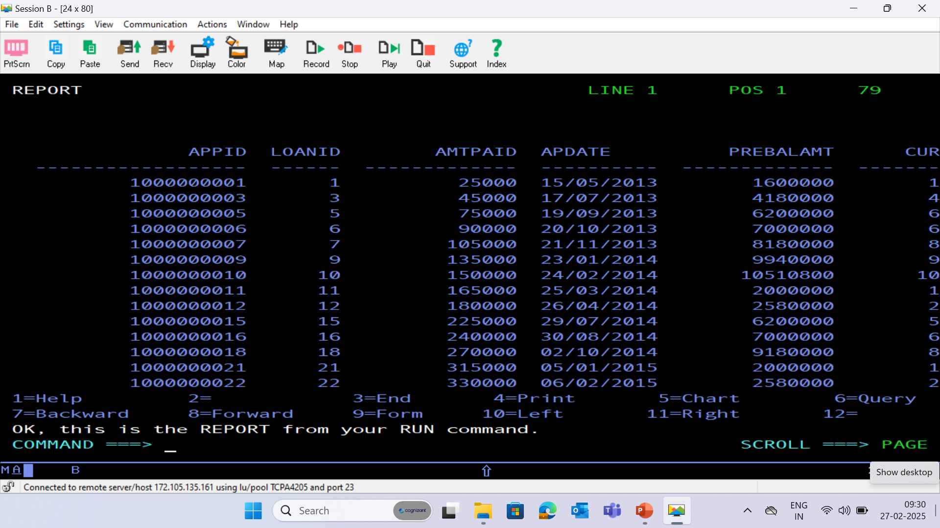
PAYMENT DATABASE - (PAYMENT)

Slide 22
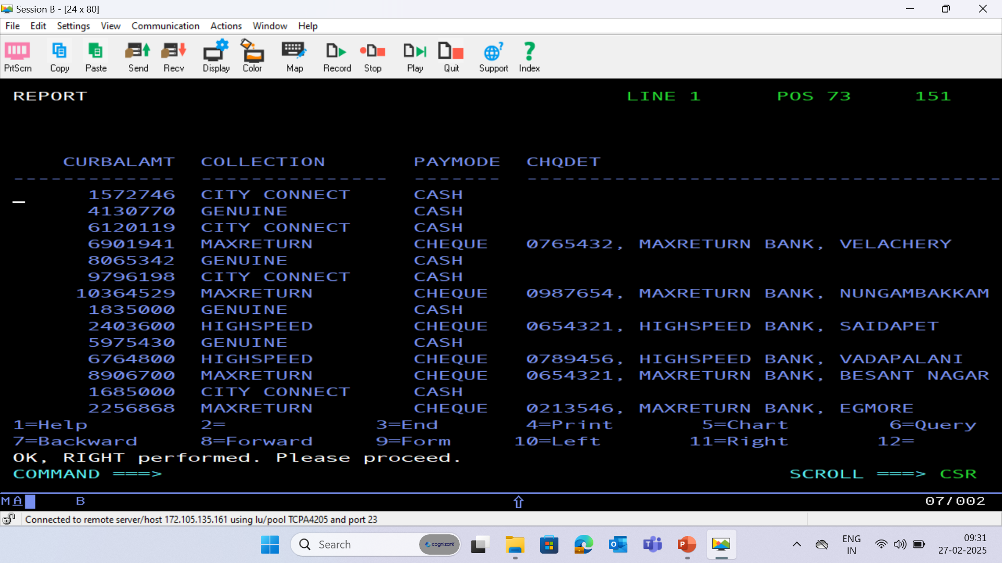

Slide 23
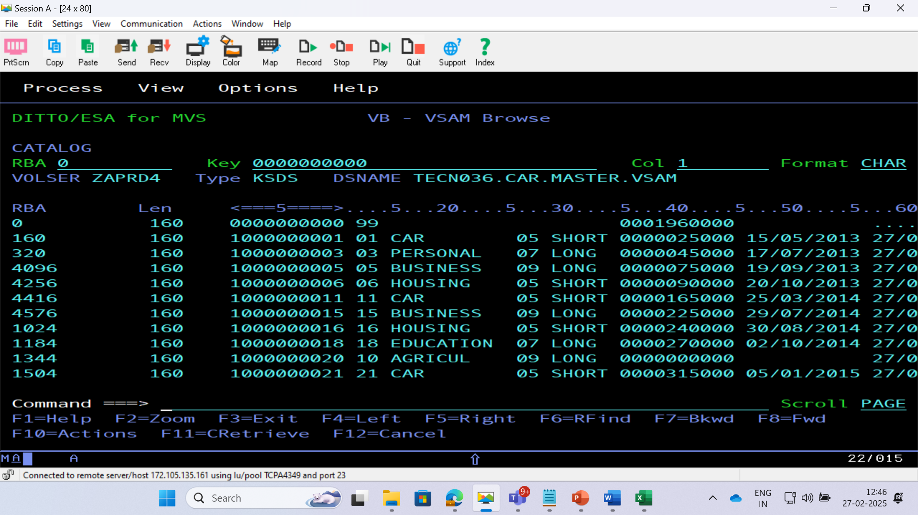
BRD 02 VSAM CLUSTER

Slide 24
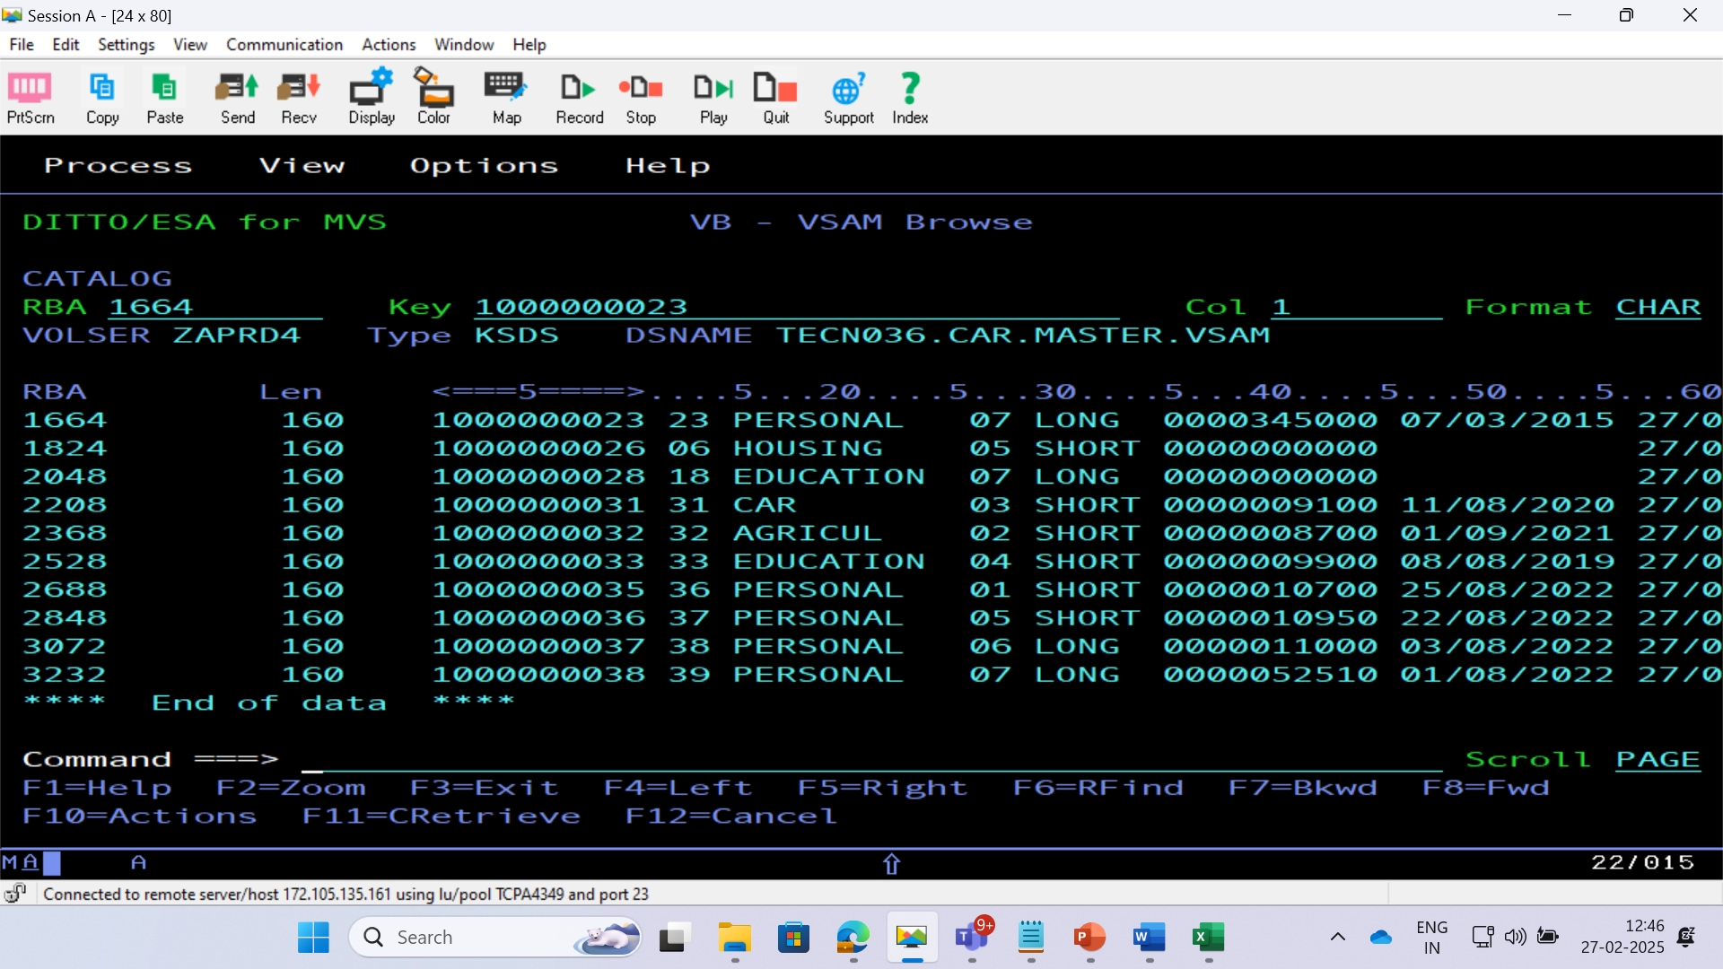

Slide 25
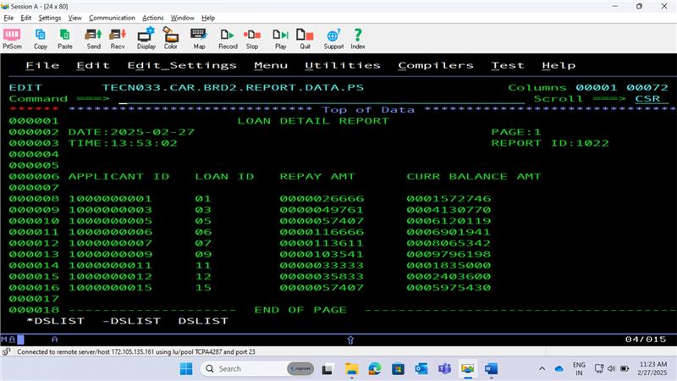
BRD 02 REPORT PS FILE

Slide 26
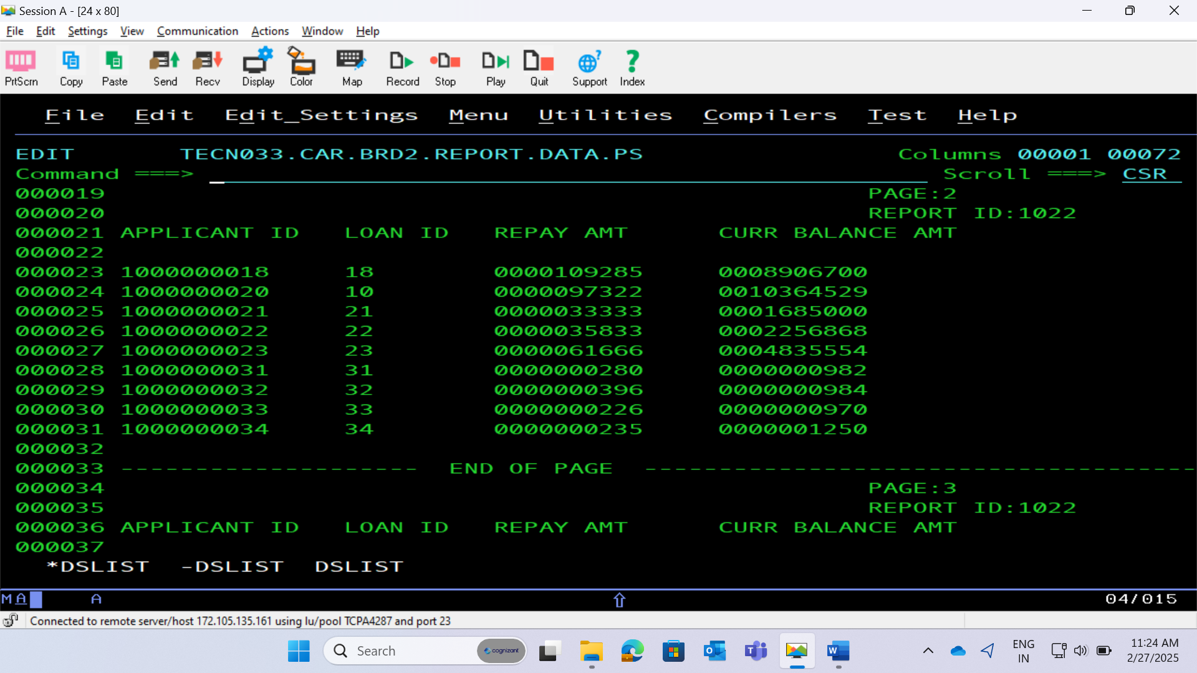

Slide 27
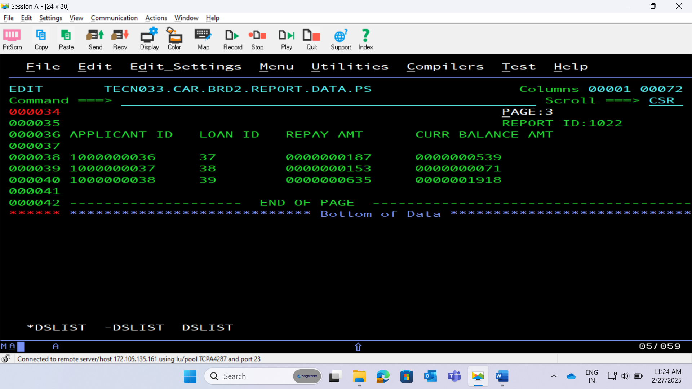

Slide 28
THANK YOU

Slide 29
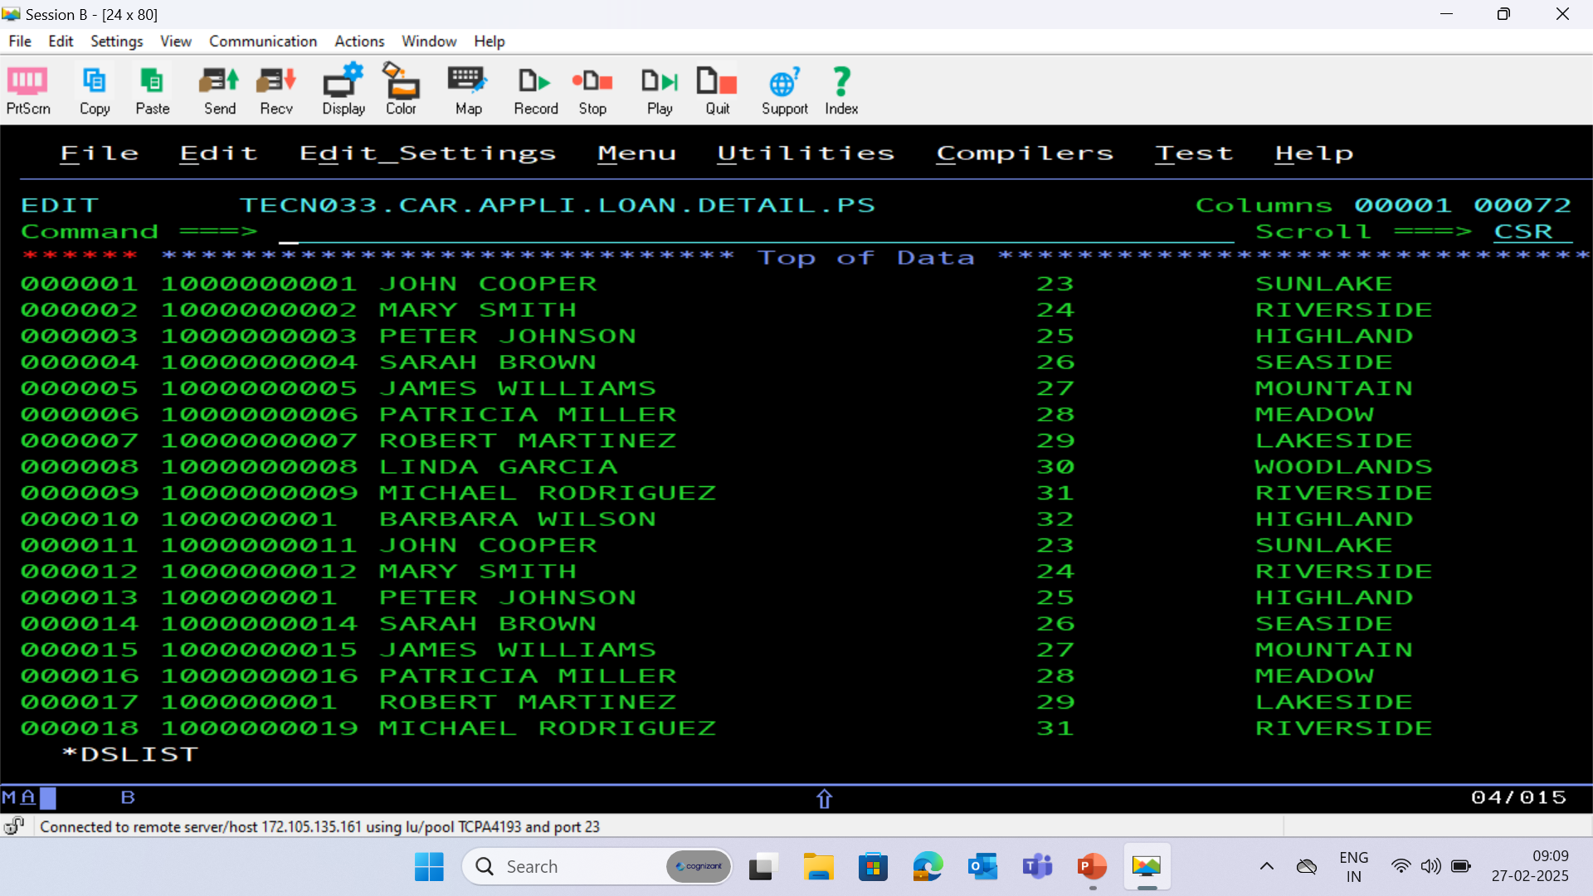
APPLICATION PS FILE

Slide 30
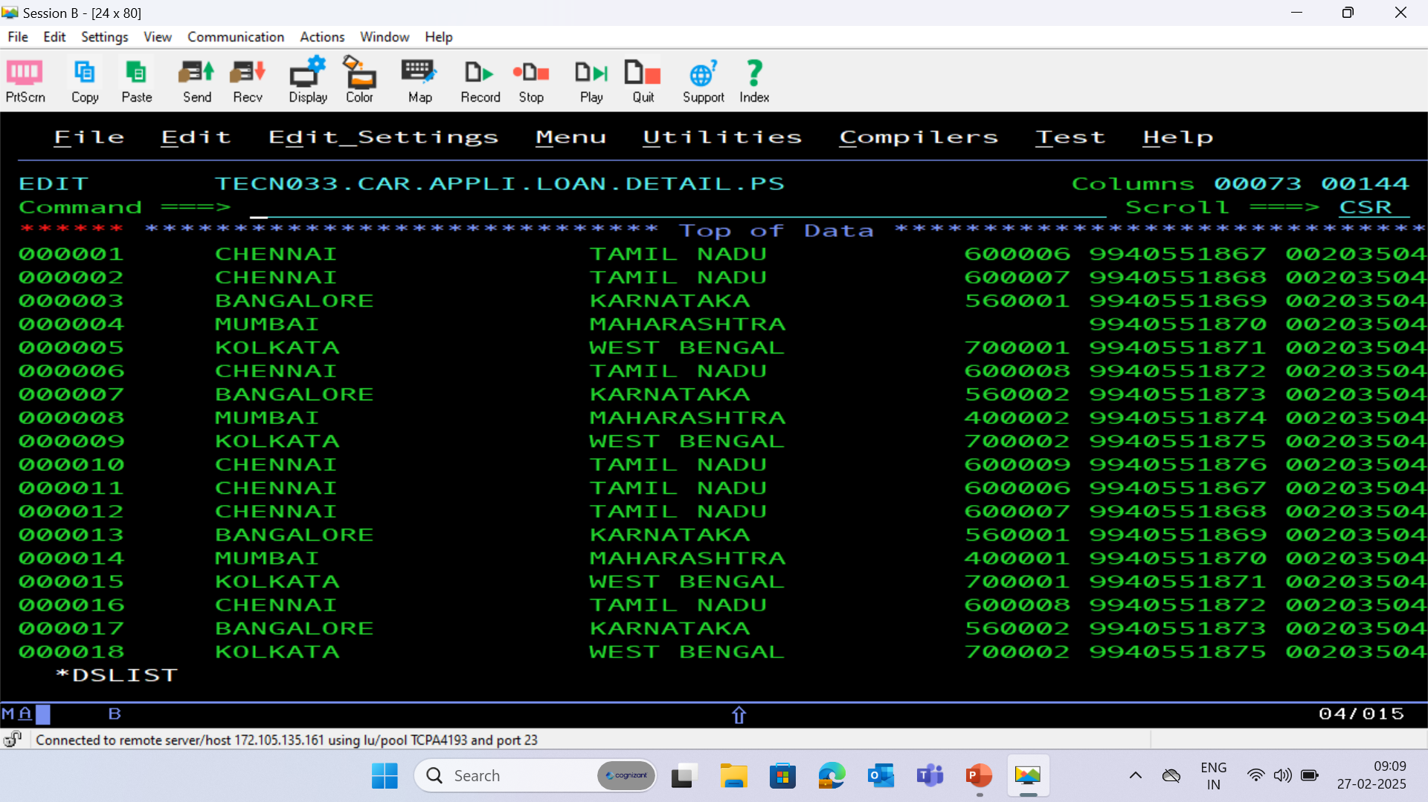

Slide 31
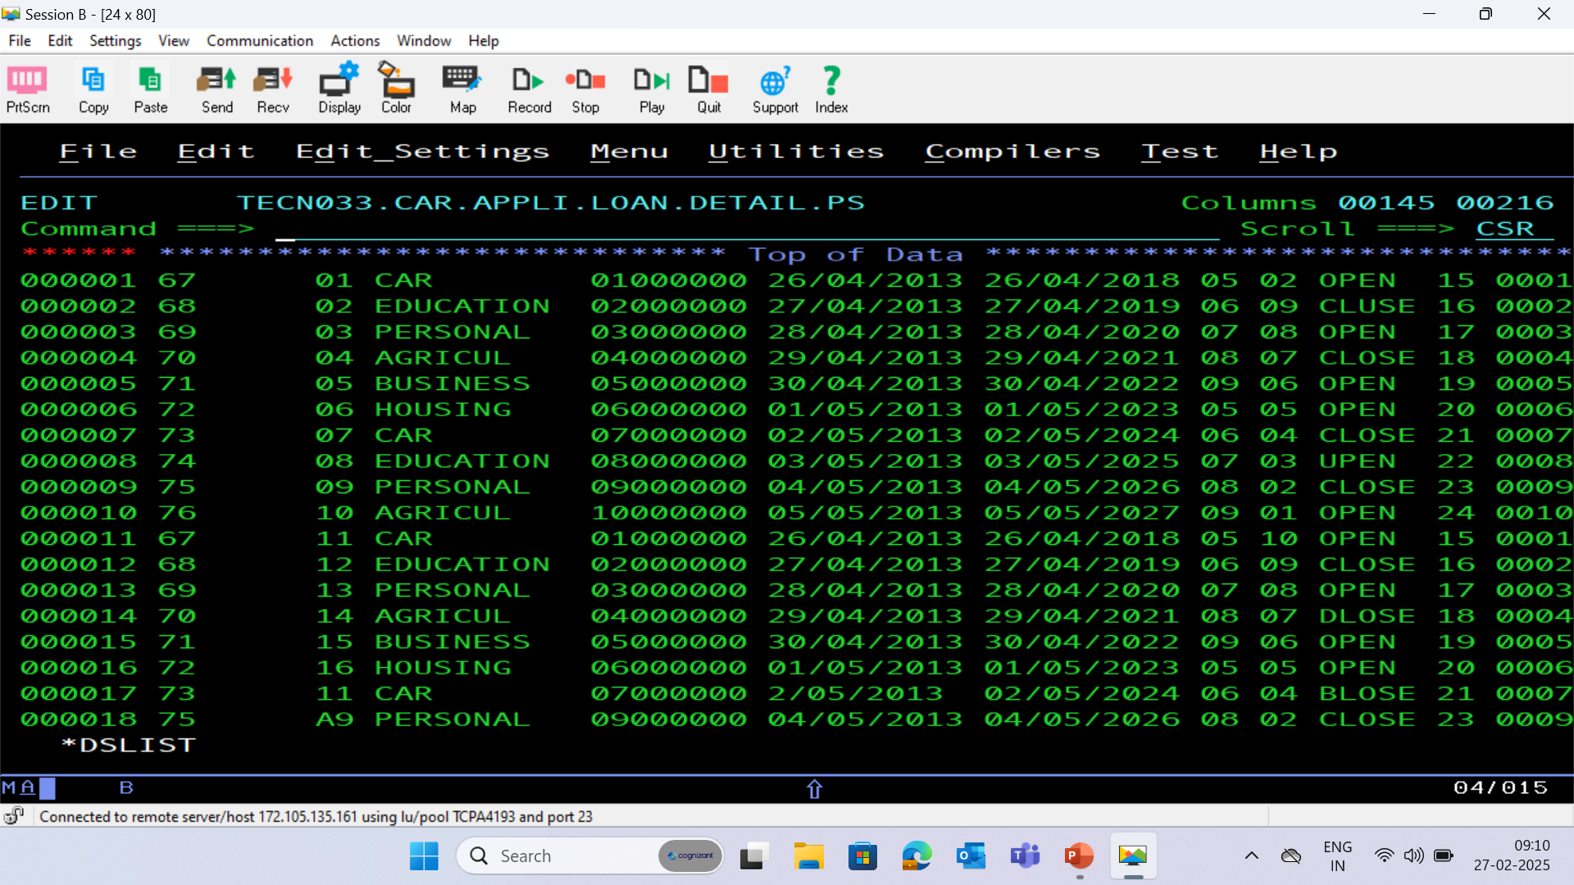

Slide 32
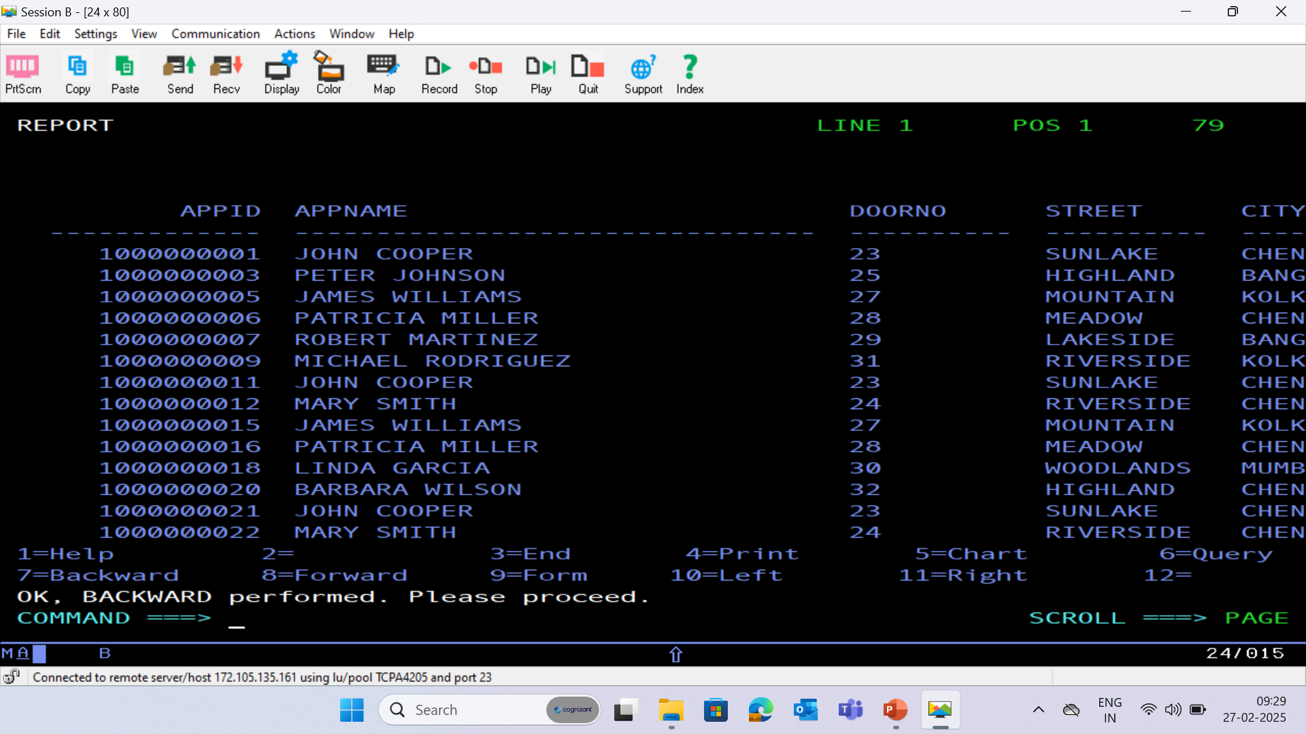
APPLICATION DATABASE - (APPLC)

Slide 33
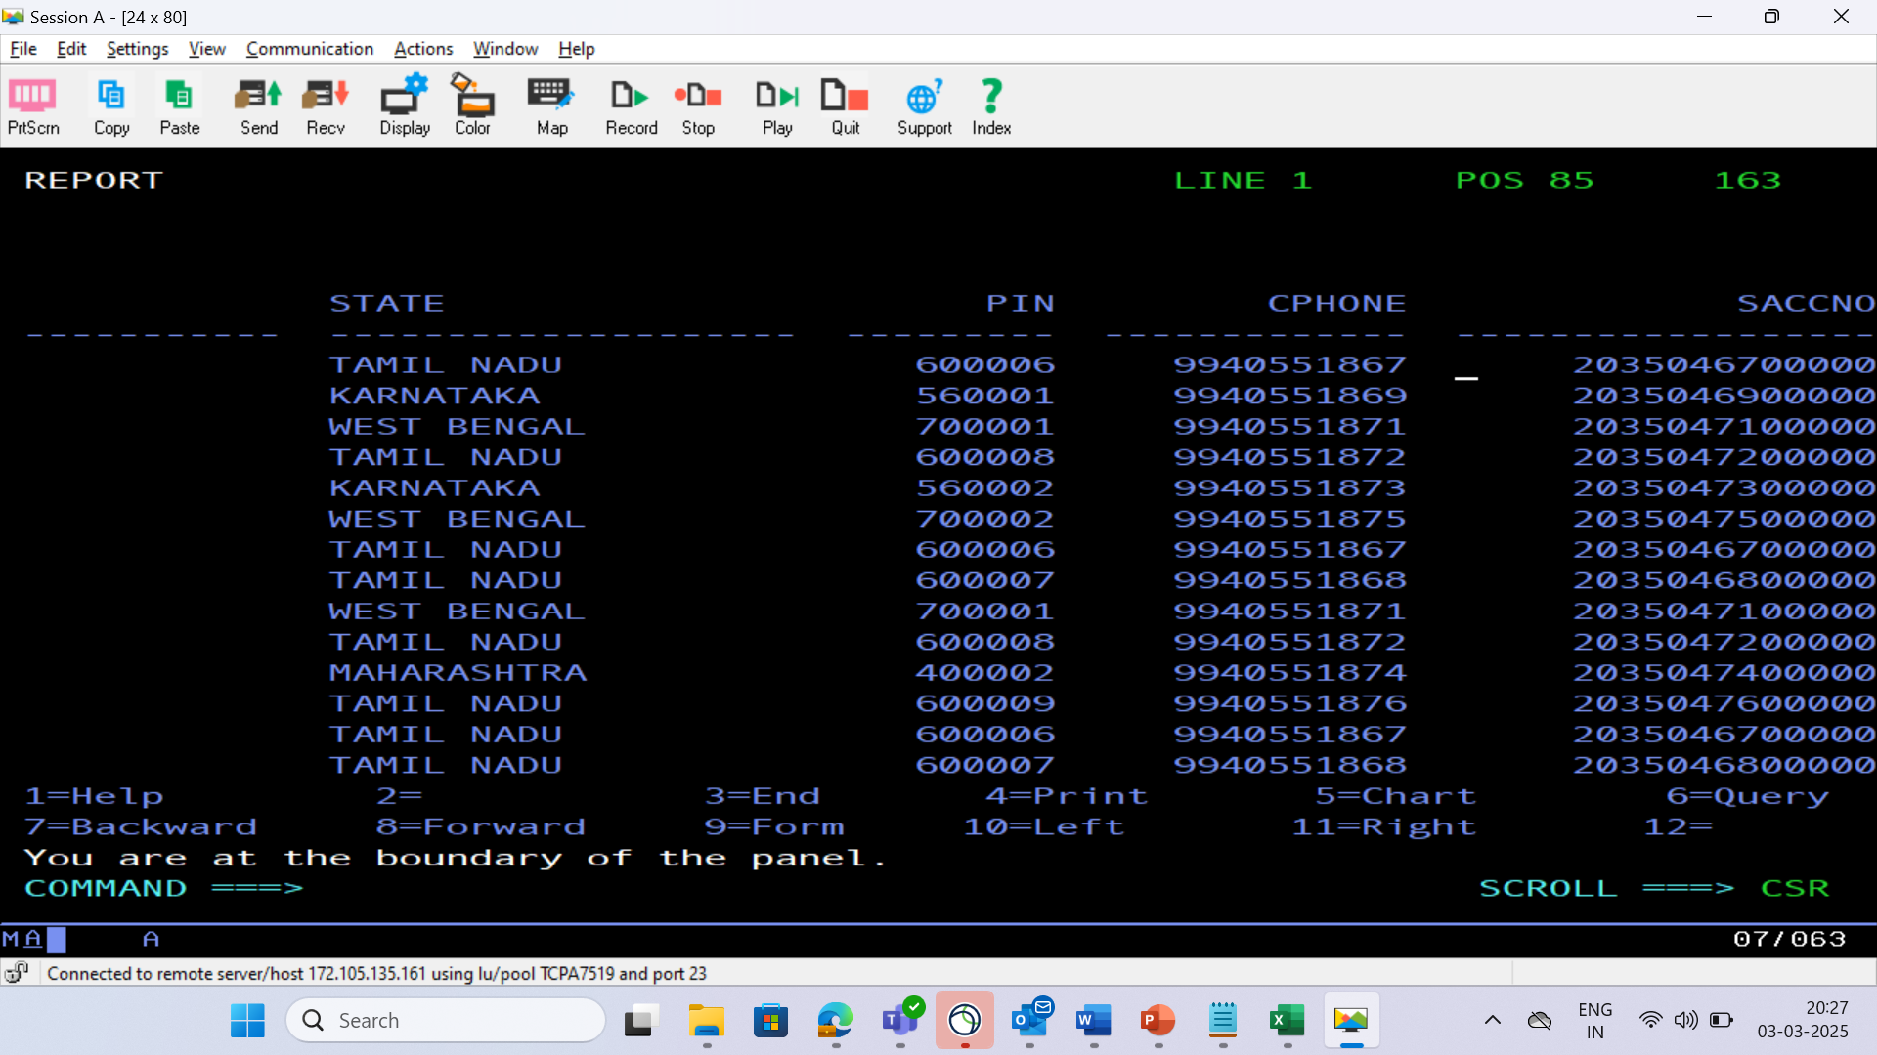

Slide 34
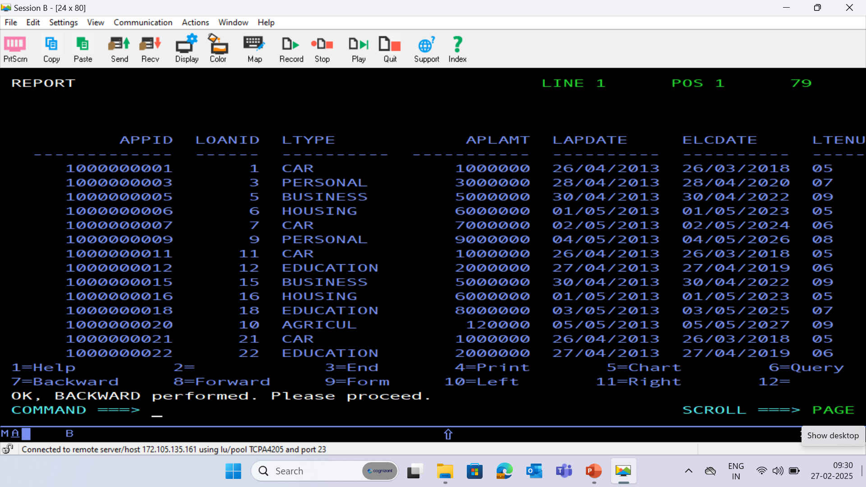
LOAN DATABASE - (LOAN)

Slide 35
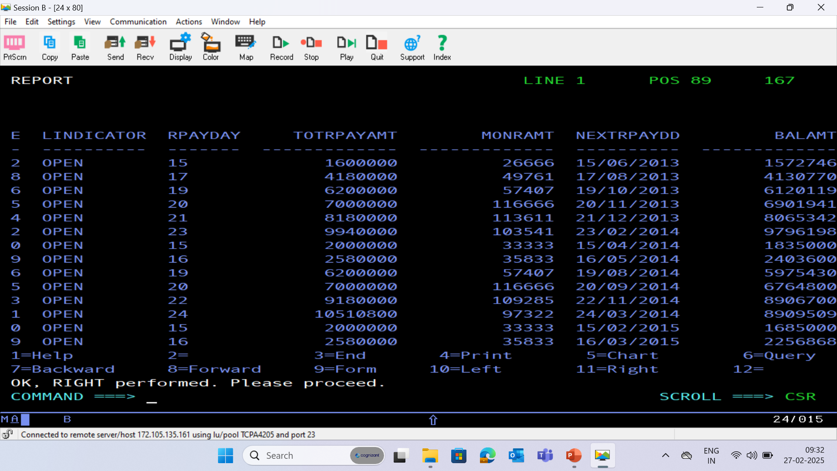

Slide 36
PAYMENT PS FILE

Slide 38
PAYMENT DATABASE - (PAYMENT)

Slide 40
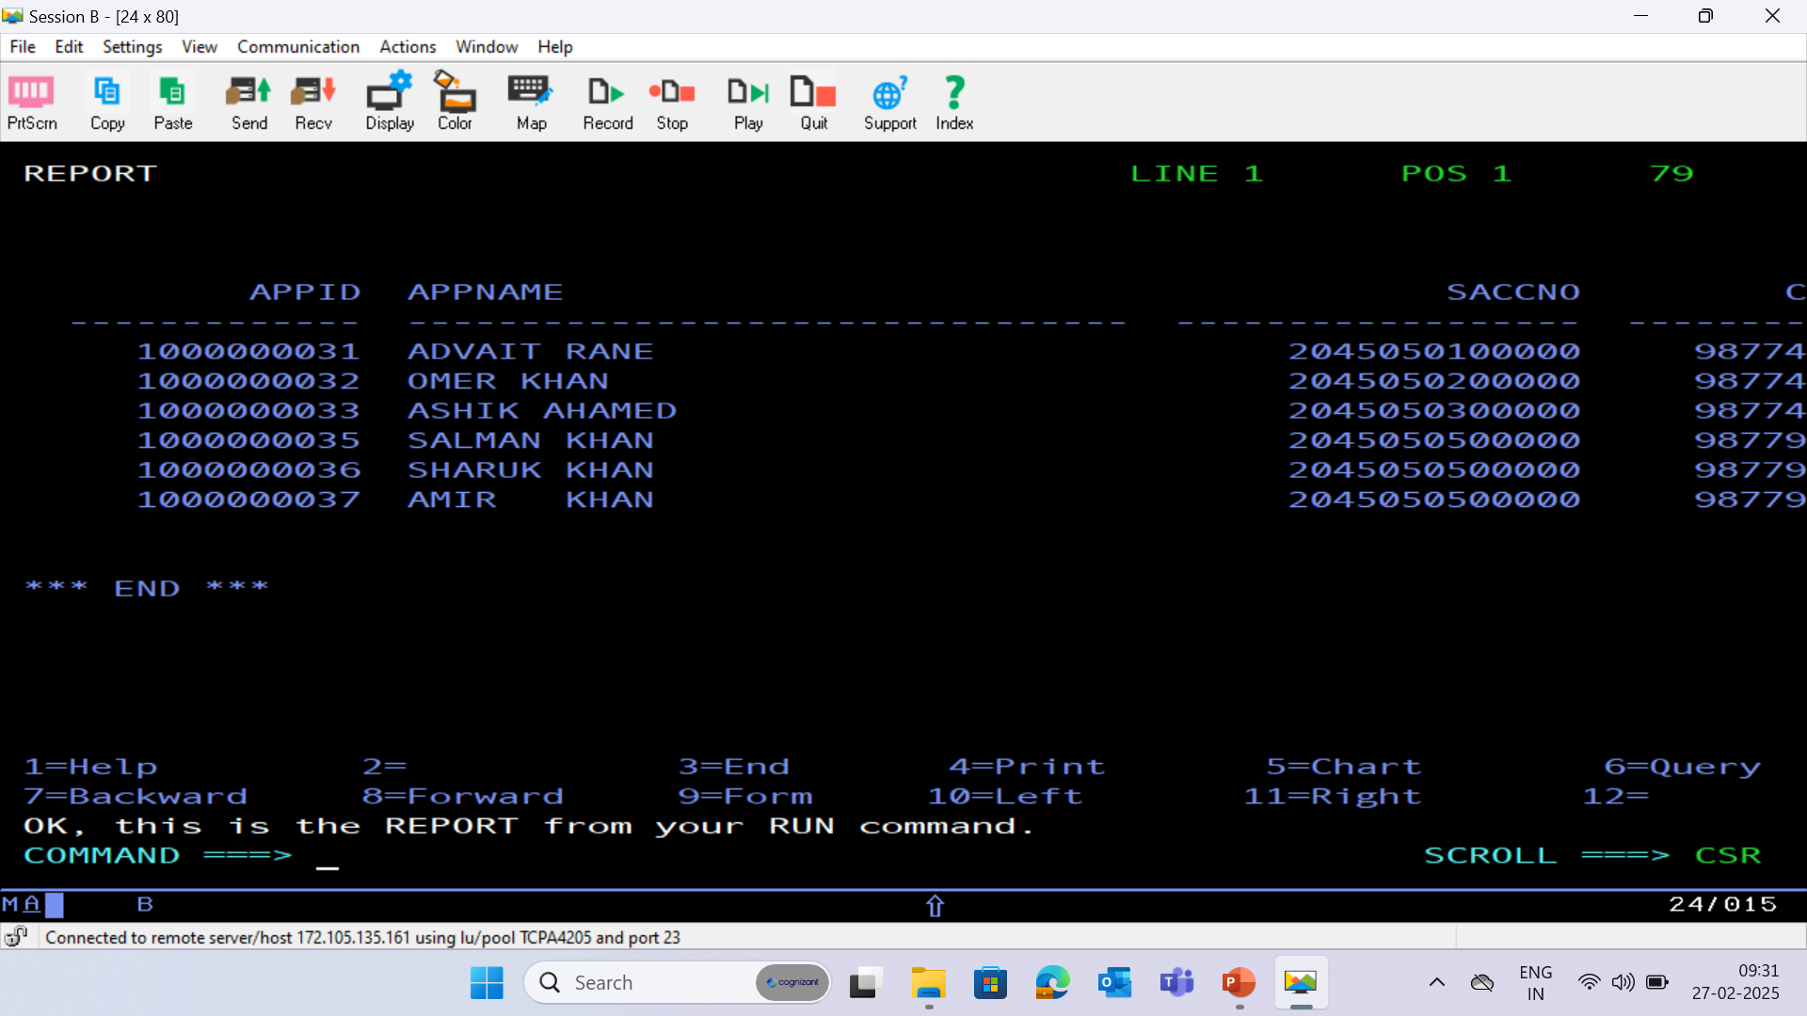
HISTORY DATABASE - (HISTORY)

Slide 41
